Slide 1
What’s in the Water? Indicators of Water Quality
Citizen Science 2.0

Slide 2
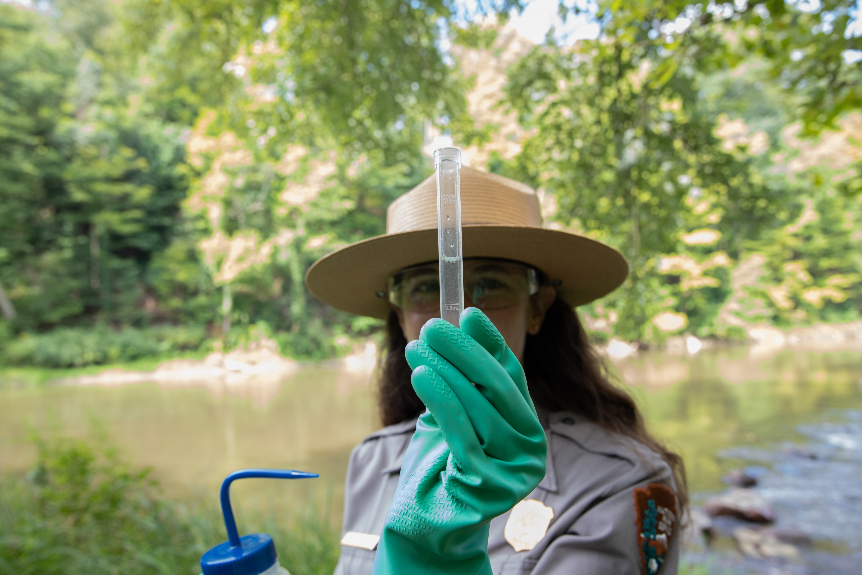
Water Quality Kit Tests
pH
Nitrates and Phosphates
Dissolved Oxygen
Turbidity
Photo courtesy Conservancy

Slide 3
What is pH?
A measure of the concentration of hydrogen ions in solution
An acid is a substance that donates hydrogen ions whereas a base is a substance that accepts hydrogen ions
The pH will be less than 7 if an acid is dissolved in water and greater than 7 if a base (alkali) is dissolved in water; a pH of 7 is considered neutral
Denoted on a numeric scale from 1 to 14

Slide 4
What causes changes in pH?
Acid precipitation
Industrial pollution
Agricultural runoff

Slide 5
Why does pH matter?
Aquatic organisms are sensitive to pH, especially during reproduction
Changes in pH can alter protein function in organisms
pH can affect the toxicity of many substances in the water
Diagram courtesy the Stroud Water Research Center’s WikiWatershed Application: https://wikiwatershed.org
Based on the diagram, what pH range would be an indication of a healthy stream?

Slide 6
What are Nitrates and Phosphates?
Forms of nitrogen and phosphorus that are essential nutrients for plants and algae
Nitrates and phosphates are nutrients needed by all plants and animals to build protein and grow
Orthophosphates are inorganic phosphates present in waterways that can easily be taken in by aquatic plants
Often denoted in ppm or mg/L

Slide 7
What causes changes in Nitrate and Phosphate levels?
Sewage discharges, failing septic systems, runoff from manure and industrial fertilizers, decomposition
Excess phosphate can also be carried into waterways via soil erosion
Rocks are a main reservoir for phosphorous in an ecosystem

Slide 8
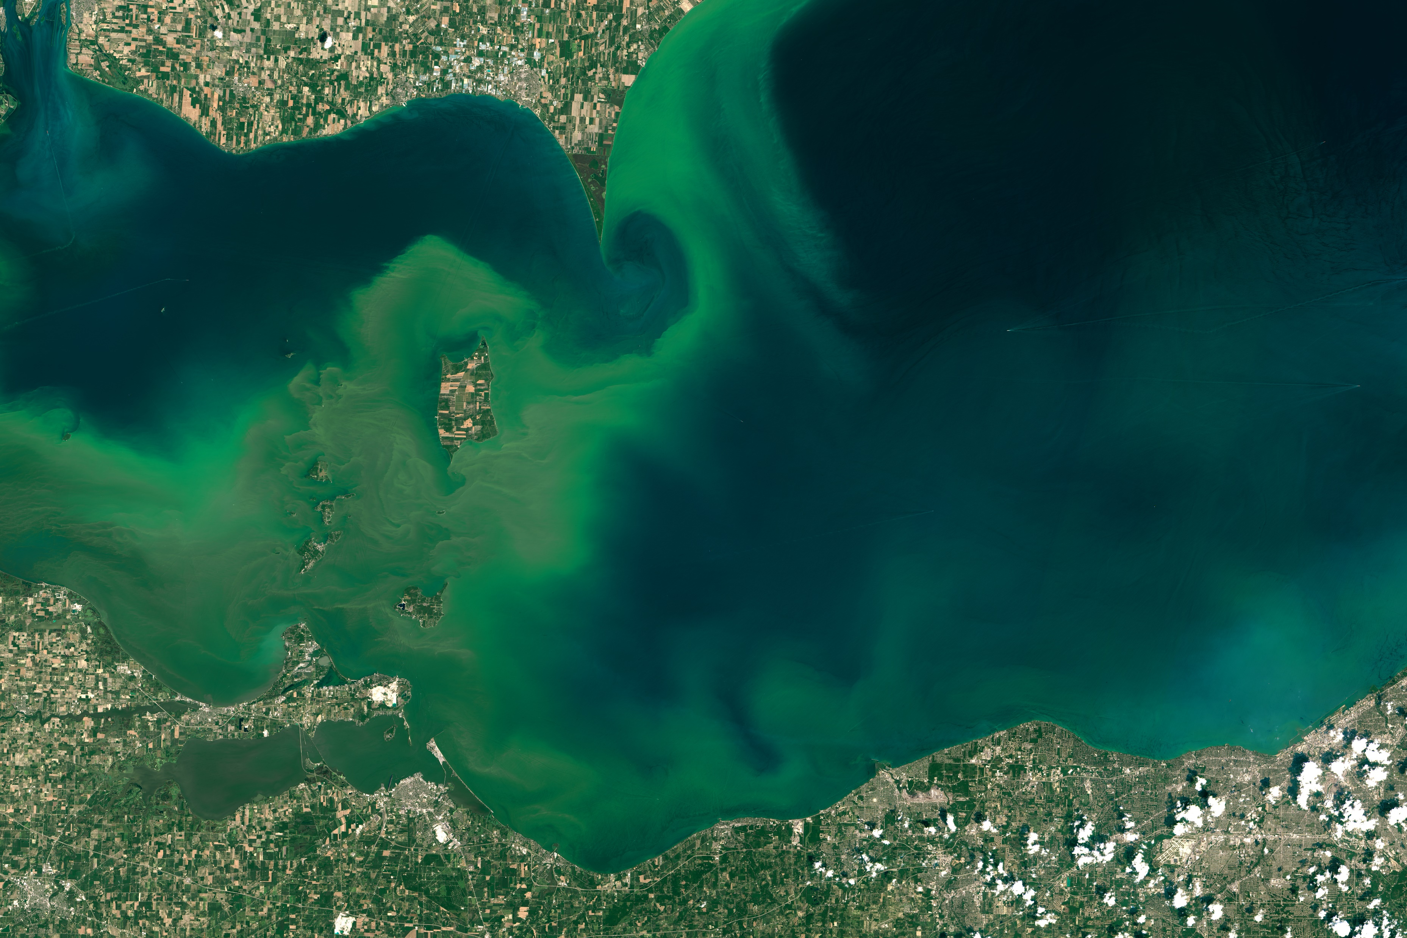
Why do Nitrates and Phosphates matter?
Nitrogen and phosphorous are considered limiting nutrients
Excess nitrates and phosphates can cause increases in algae/plant growth leading to eutrophication and possibly hypoxia
Photo courtesy NASA Earth Observatory: https://earthobservatory.nasa.gov/images/86327/algae-boom-in-lake-erie
Satellite imagery of toxic algal blooms in western Lake Erie in 2015. Excess algae growth was attributed to agricultural runoff.

Slide 9
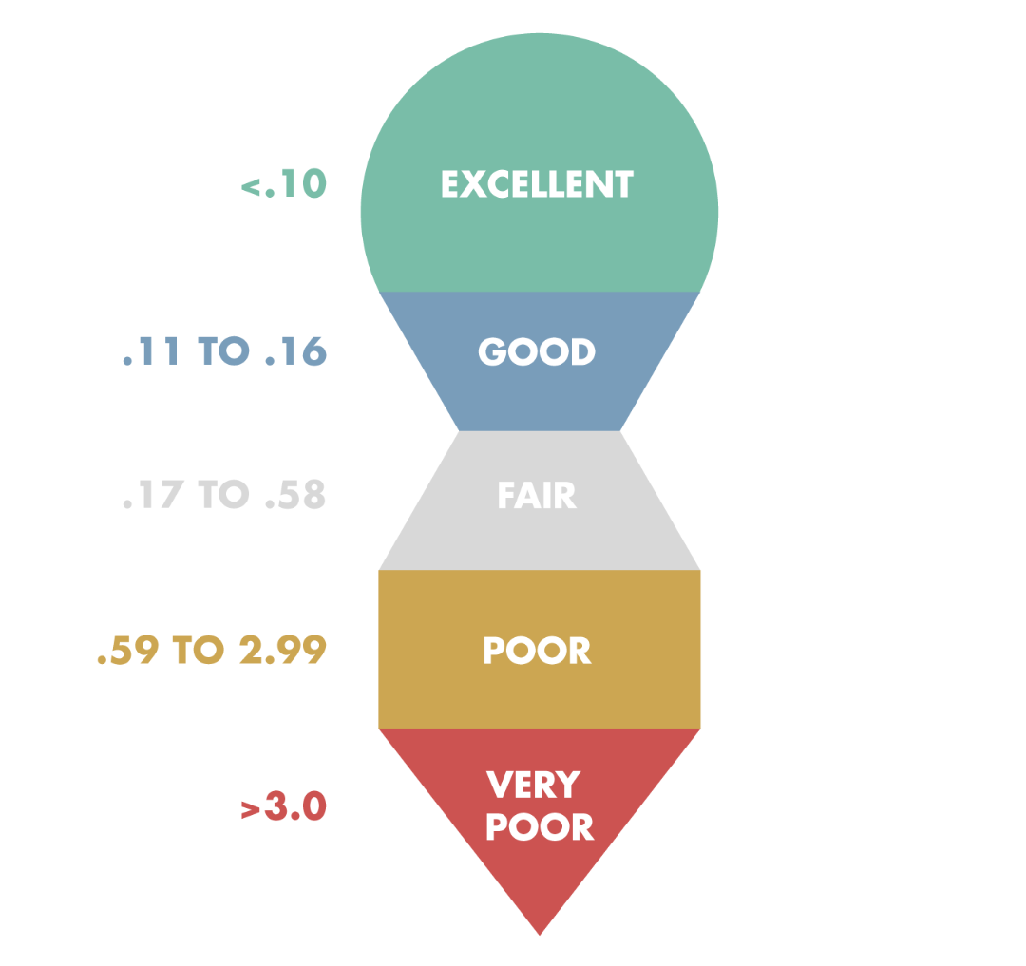
What are acceptable levels of Nitrates and Phosphates?
Nitrates (mg/L)
Phosphates (mg/L)
Diagrams courtesy the Stroud Water Research Center’s WikiWatershed Application: https://wikiwatershed.org

Slide 10
What is Dissolved Oxygen?
A measure of the amount of oxygen dissolved in water
Low or absent levels of dissolved oxygen (DO) indicate severe pollution
A value of 71% oxygen saturation or greater is preferred
Often denoted in ppm or mg/L

Slide 11
What causes changes in Dissolved Oxygen levels?
Can be changed by temperature, photosynthesis, plant growth, decaying matter, water movement, and turbidity
Colder water can hold more DO than warmer water

Slide 12
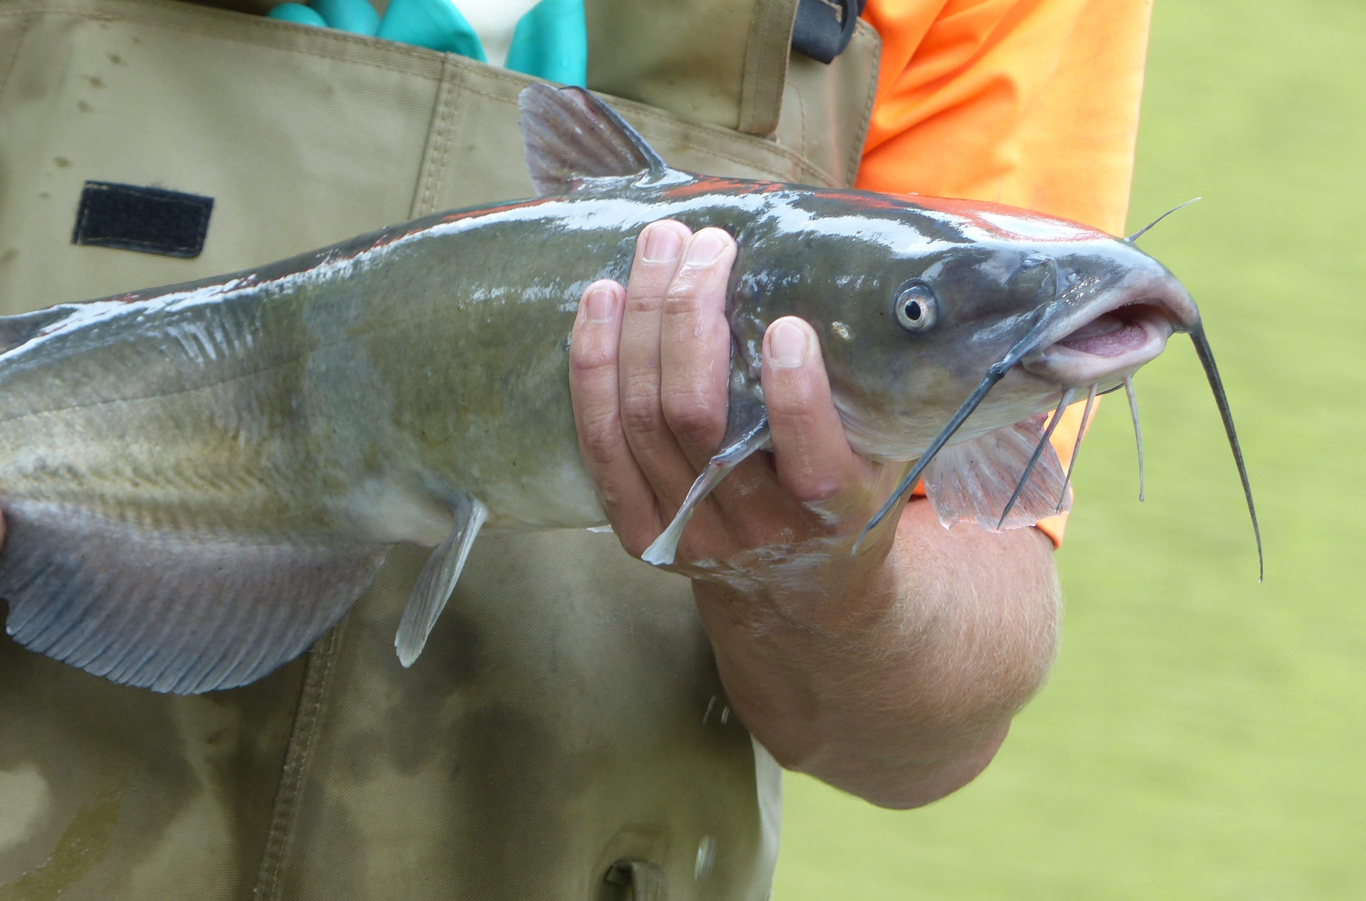
Why does Dissolved Oxygen matter?
DO is fundamental to the survival of most aquatic organisms as it is used for cellular respiration
Very low DO can lead to a condition called hypoxia and results in fish die-offs
Some organisms are adapted to low DO levels and can ingest air directly
NPS Photo
Many aquatic life forms, such as fish and insect larvae, require acceptable levels of dissolved oxygen in the streams and rivers where they live.

Slide 13
What are acceptable levels of Dissolved Oxygen?
DO (mg/L)
Diagram courtesy the Stroud Water Research Center’s WikiWatershed Application: https://wikiwatershed.org

Slide 14
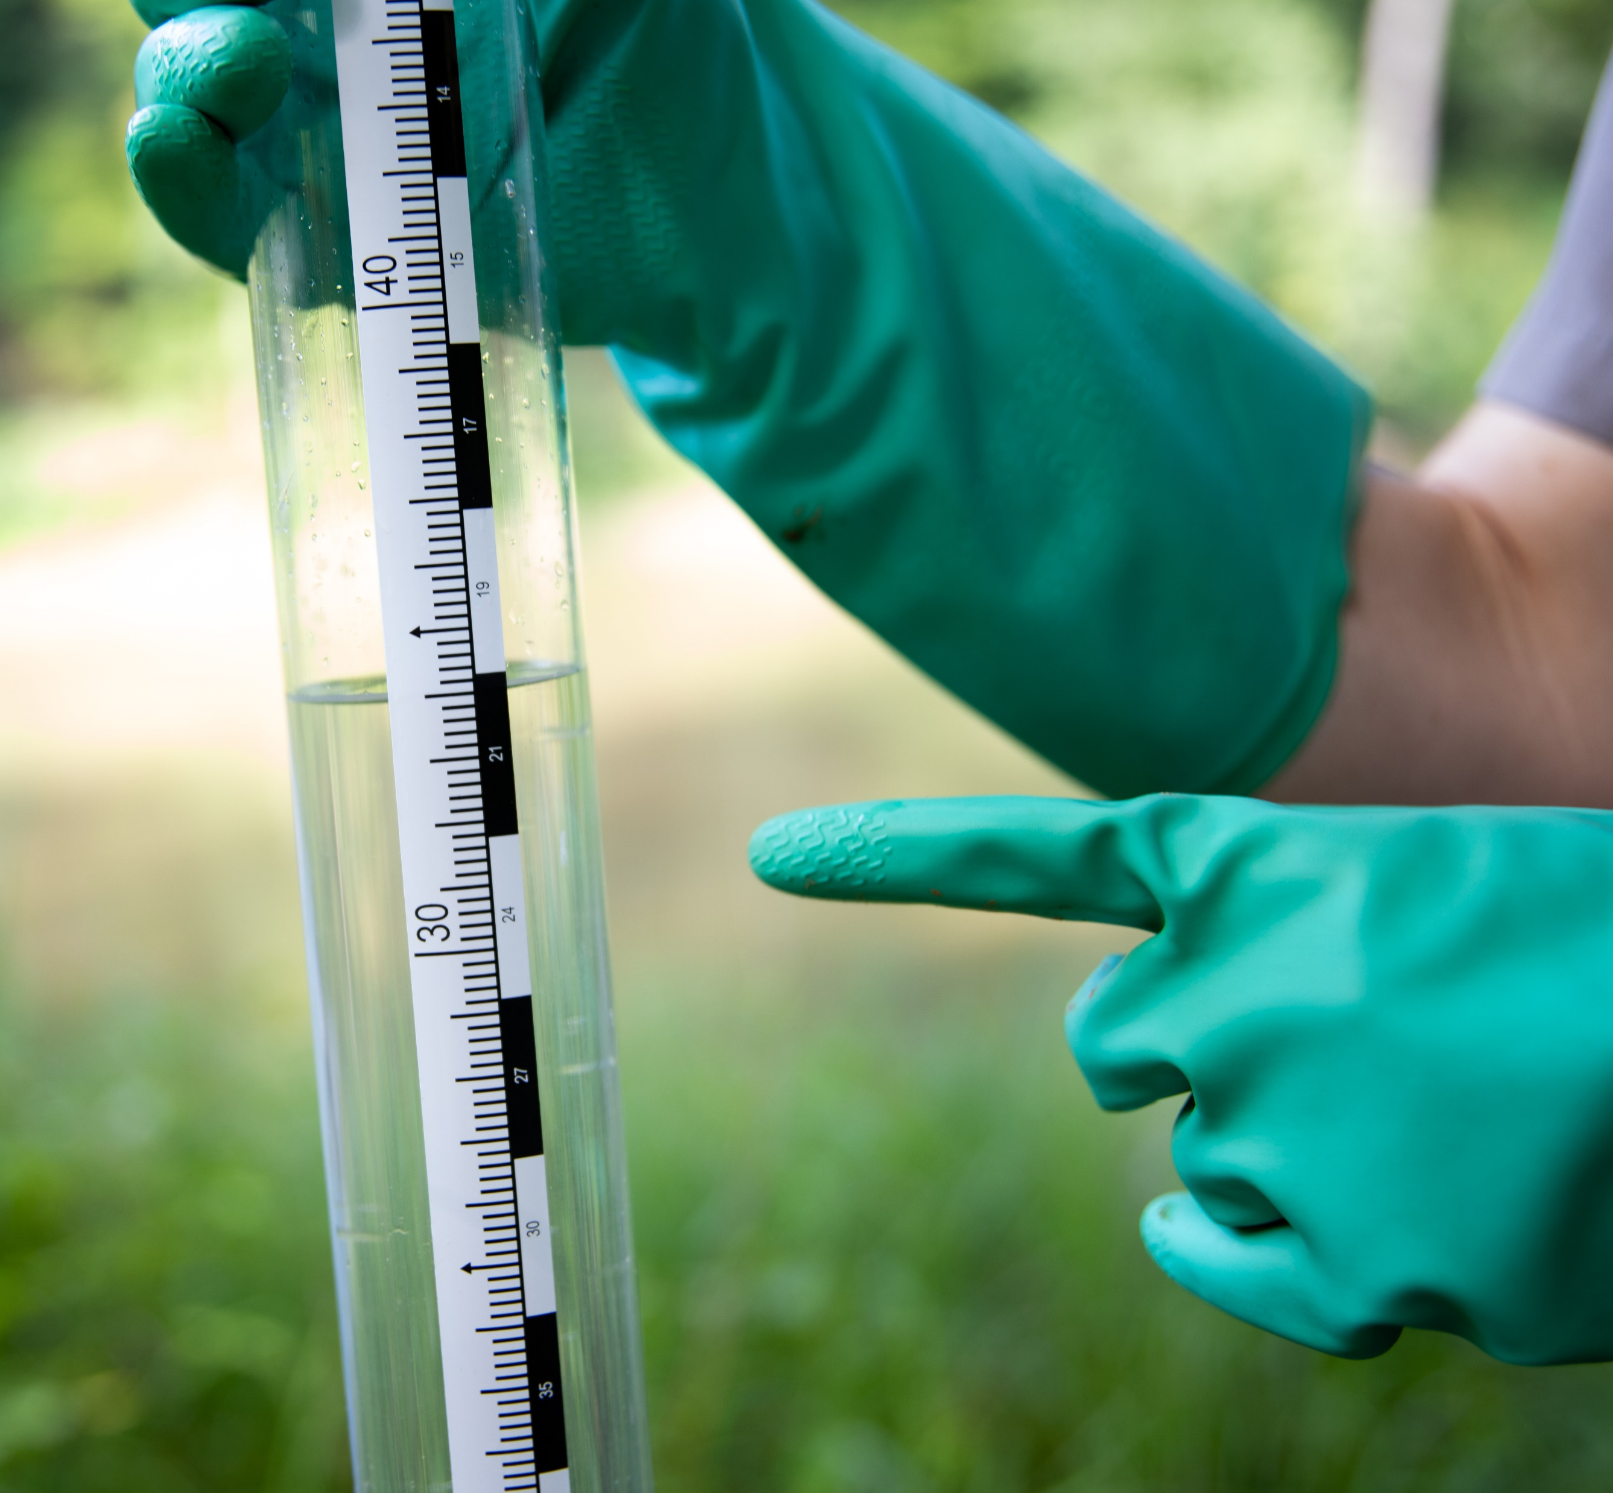
What is Turbidity?
A measure of the clarity or relative cloudiness of the water
Can be determined by using a turbidity tube (pictured)
Often denoted in Nephelometric Turbidity Units (NTU)
Photo courtesy Conservancy

Slide 15
What causes changes in Turbidity?
Suspended particles from…
Erosion
Runoff
Increased bacteria or algal blooms
Sewage
Industrial waste
Decaying organic matter
Weather events
Human disturbance

Slide 16
Why does Turbidity matter?
Excessive turbidity caused by suspended solids can impair photosynthesis, thus reducing DO
Suspended particles can absorb heat and cause a rise in water temperature, thus DO may decrease and limit biodiversity

Slide 17
What are acceptable Turbidity levels?
Turbidity (NTU)
Diagram courtesy the Stroud Water Research Center’s WikiWatershed Application: https://wikiwatershed.org

